Slide 1

E-retail factors for customer activation and retention

Slide 2
OUTLINE
Explanatory Data Analysis
Data Cleaning & Imputation
Modelling & Prediction
Conclusion

Slide 3
EXPLANATORY DATA ANALYSIS
Categorical Data Analysis
Numerical Data Analysis

Slide 4
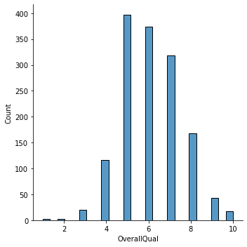
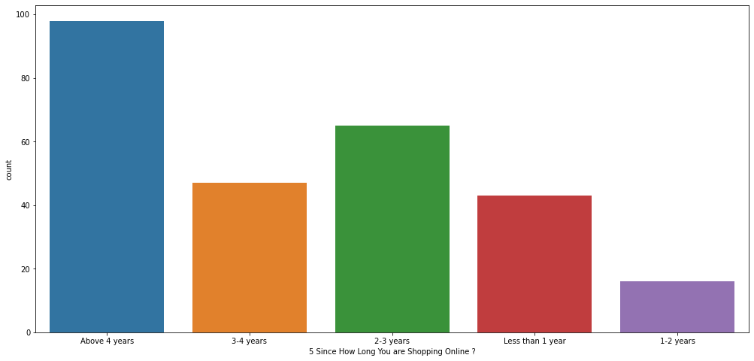
CATEGORICAL DATA ANALYSIS

Slide 5
NUMERICAL DATA ANALYSIS
Information that is measurable
Data represented as numbers and not words or text

Slide 6
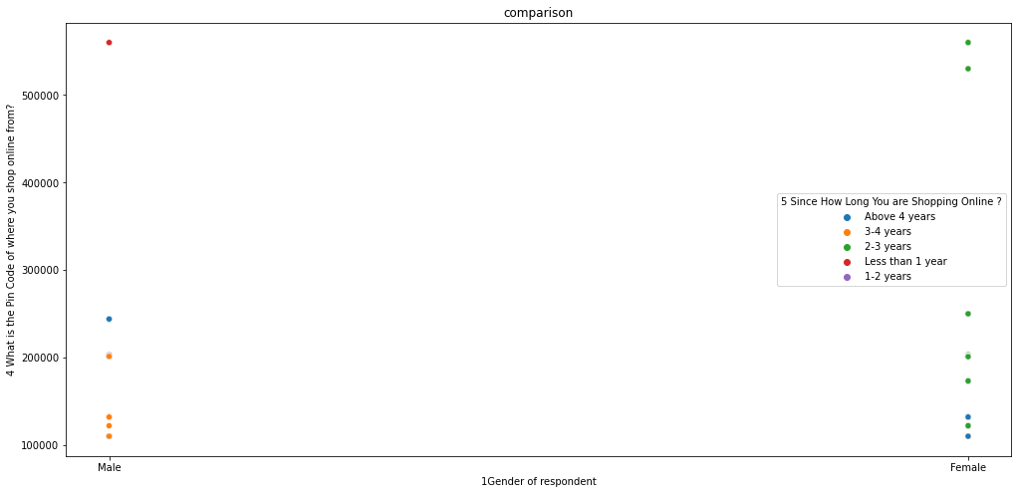
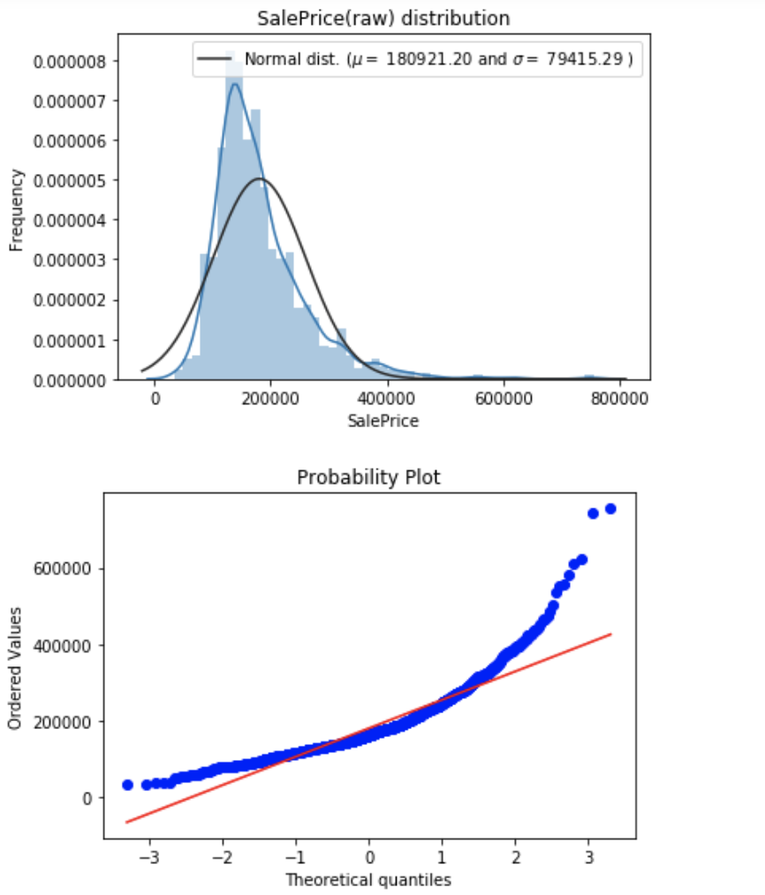
NUMERICAL DATA ANALYSIS

Slide 7
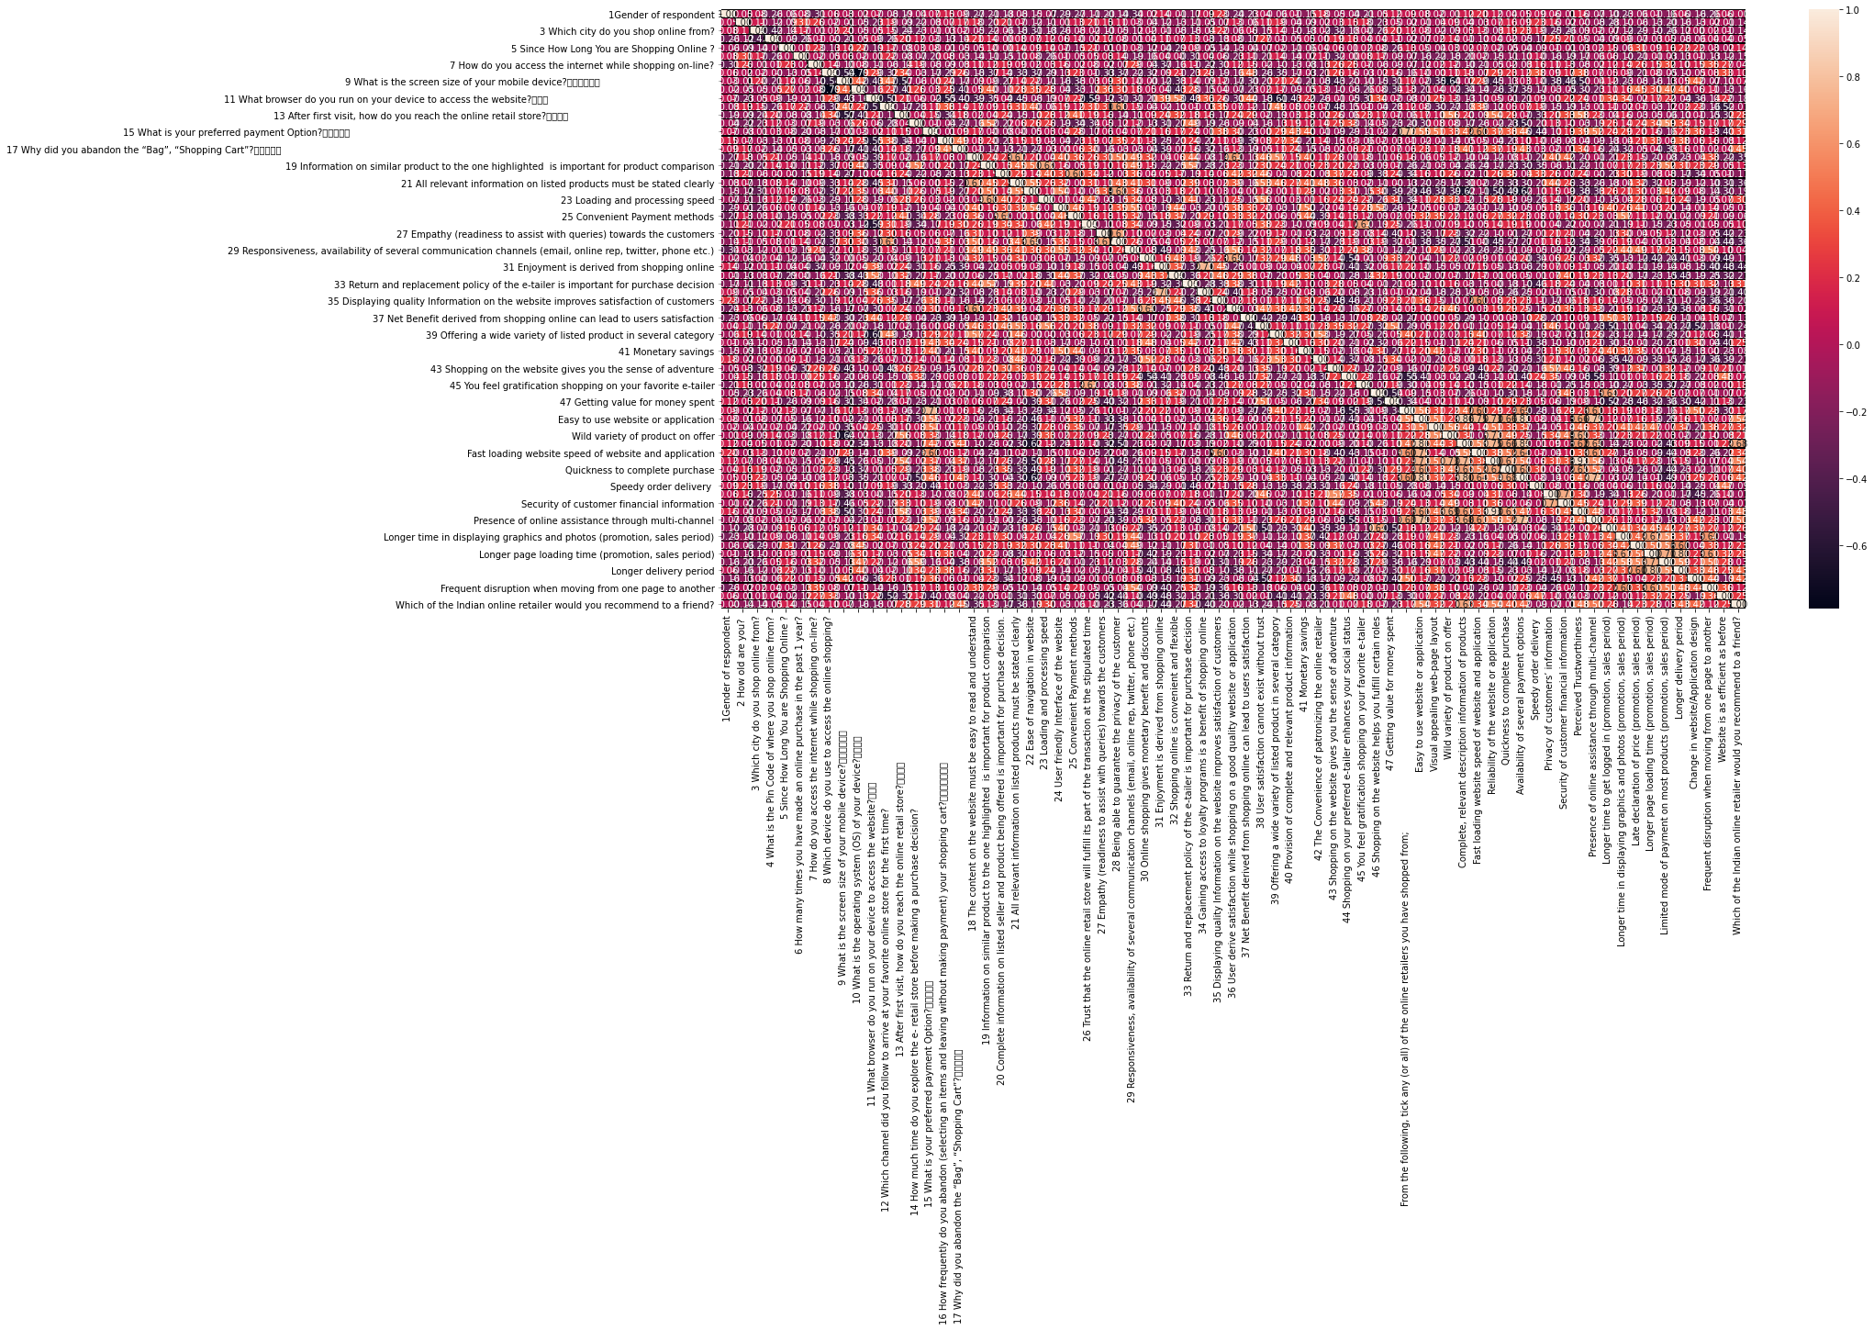
NUMERIC CORRELATION MATRIX

Slide 8
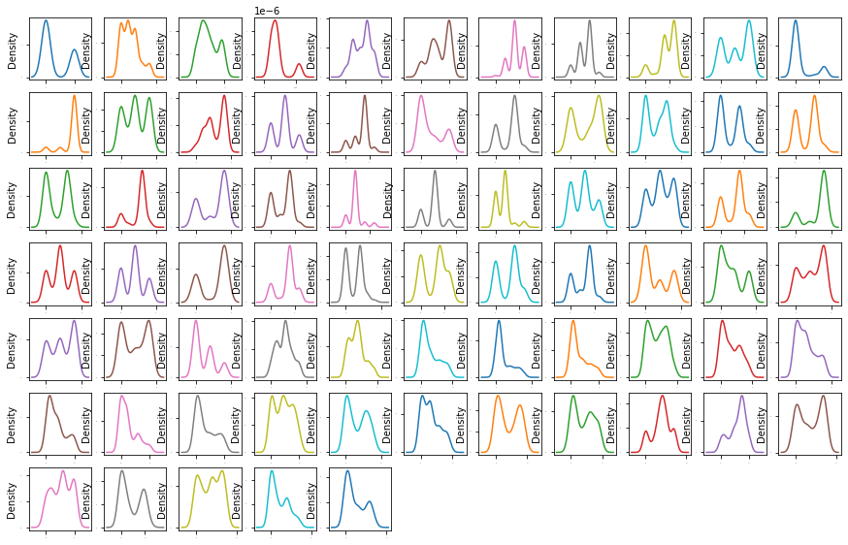
DATA ANALYSIS

Slide 9
DATA CLEANING & IMPUTATION
Checking Missing Value
Imputation

Slide 10
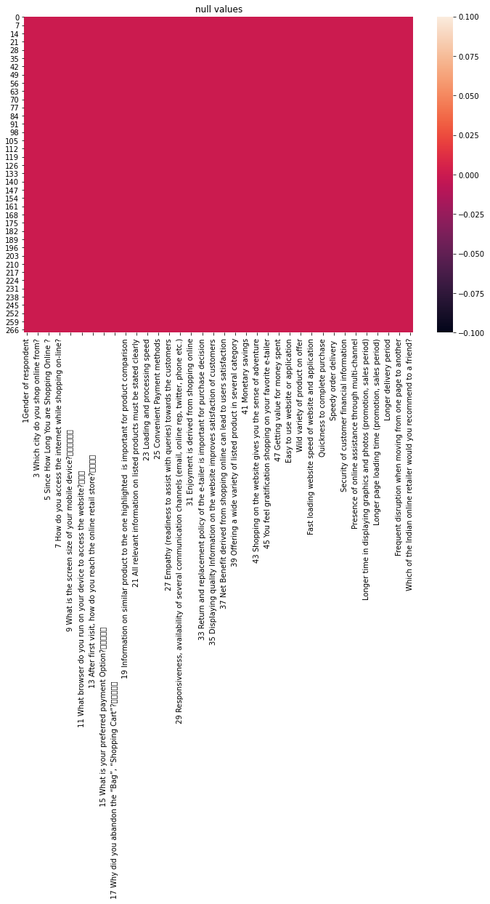
ANALYZE MISSING VALUES

Slide 11

ARE DATA REALY MISSING ?
There is no missing values

Slide 12

IMPUTATION METHODS
Median Imputation For outlier
Mode Imputation For Categorical Variables
Zero Imputation Logical reasoning

Slide 13
Model Analysis
MODELLING & PREDICTION
Linear Regression
GridSearchCV
Random Forests

Slide 14
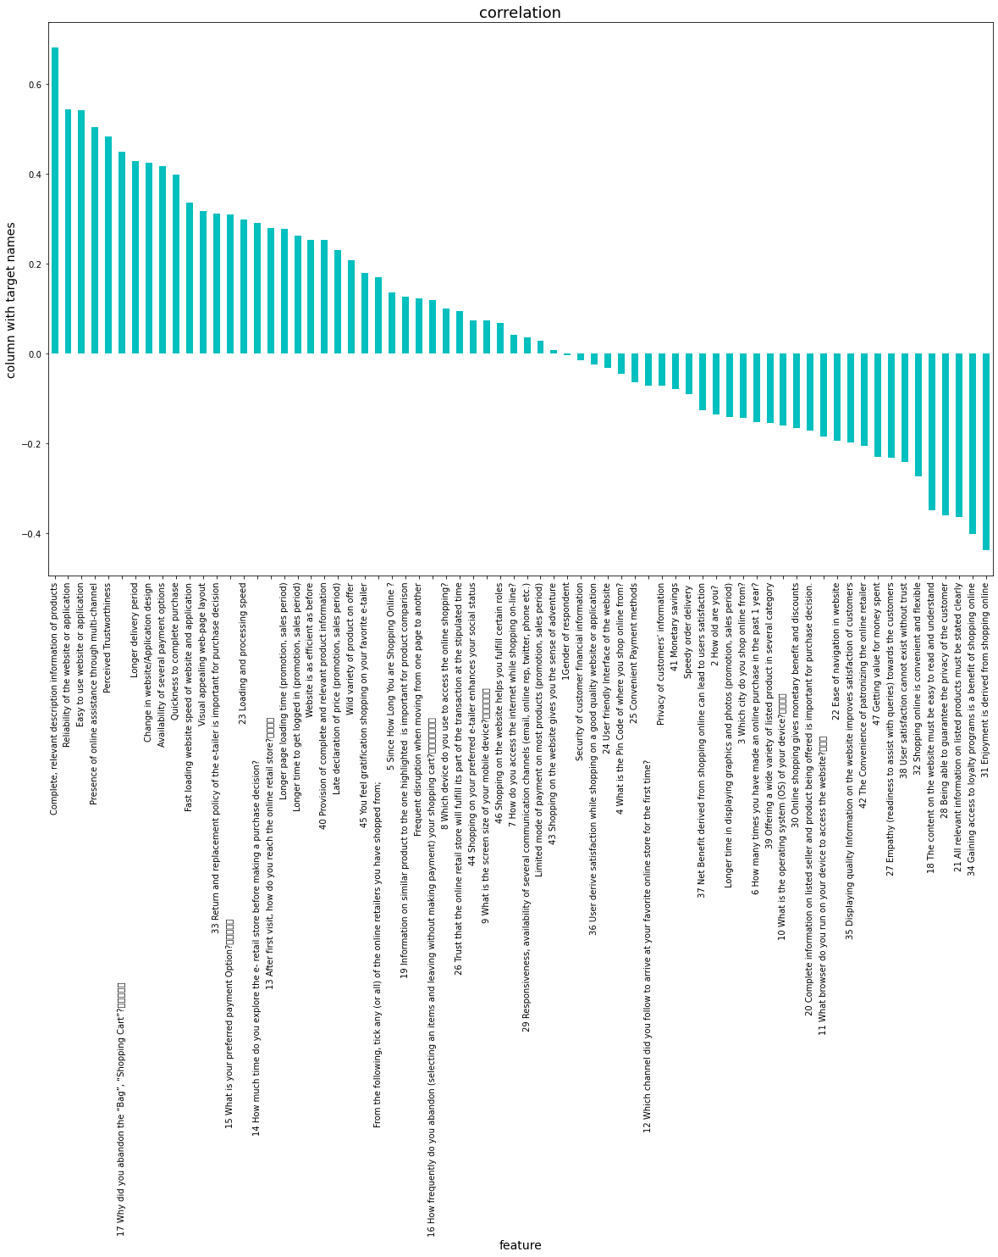
FEATURE IMPORTANCE

Slide 15
SELECTED MODEL METRICS
R2 score Was Selected For Prediction Among All the Reviewed Models

Slide 16
CONCLUSION
Feature selection can be improved upon as the remaining features were still not quite optimal.
Future work to improve prediction is to use ensemble methods to combine several methods to achieve a better prediction model.
There is room for improvement of the model with regard to the prediction technique used.
Notes:
Ensemble methods are techniques that create multiple models and then combine them to produce improved results. Ensemble methods usually produces more accurate solutions than a single model would.

Slide 17
That’s All For Now, Thank You.

